Slide 1
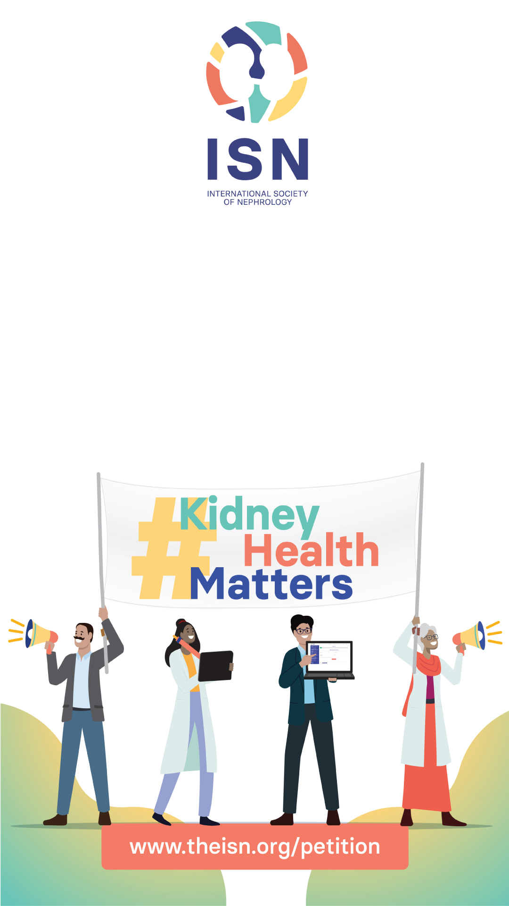
Your signature can drive
global change

Slide 2
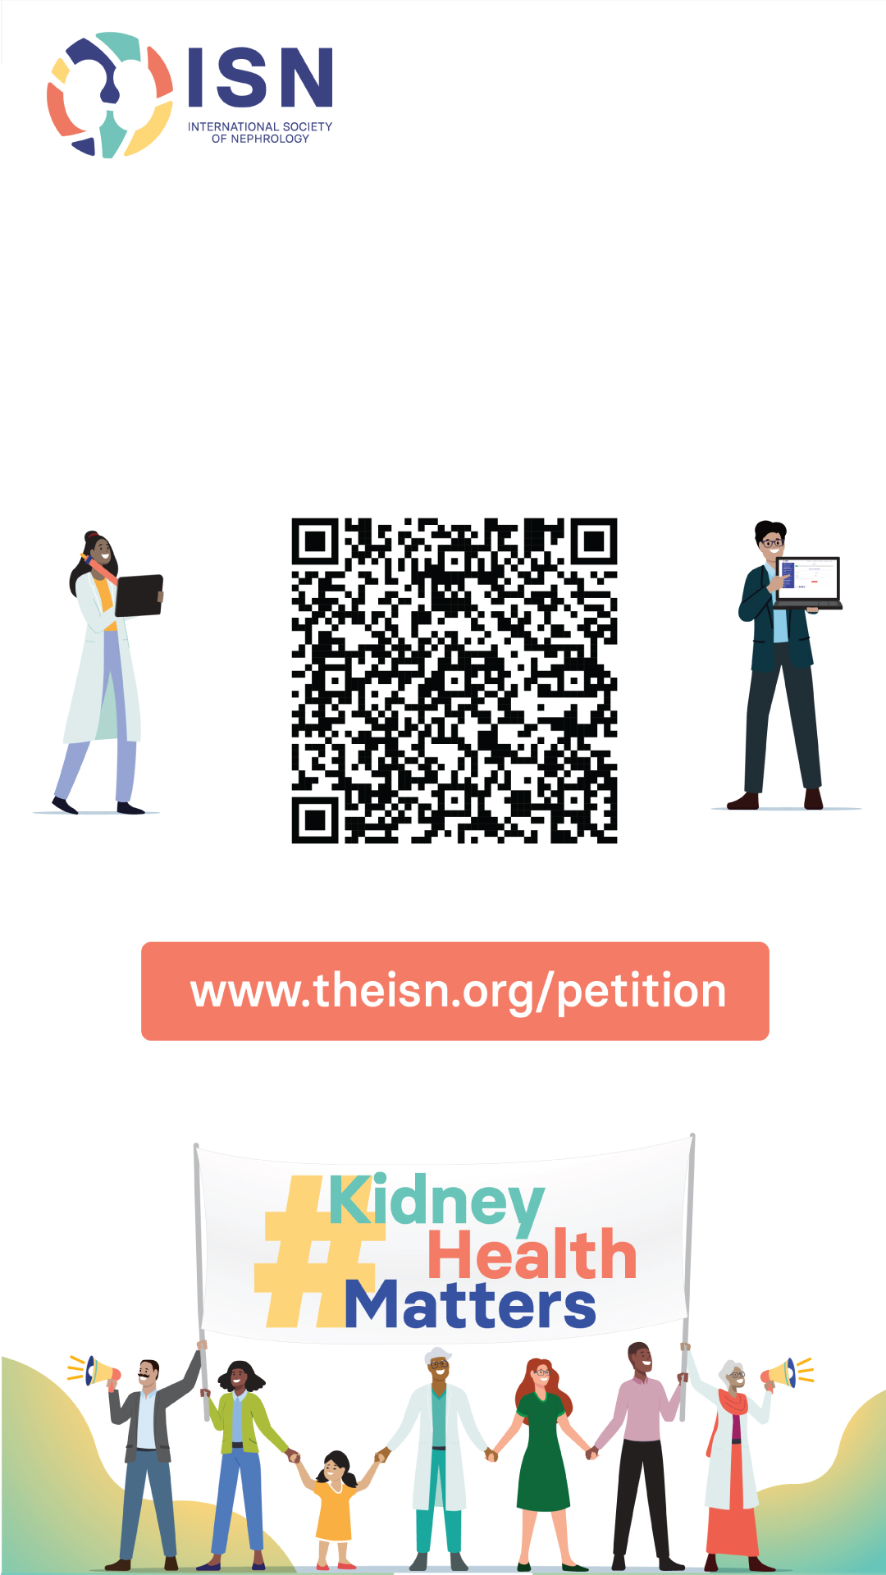
Your signature can drive global change

